Slide 1
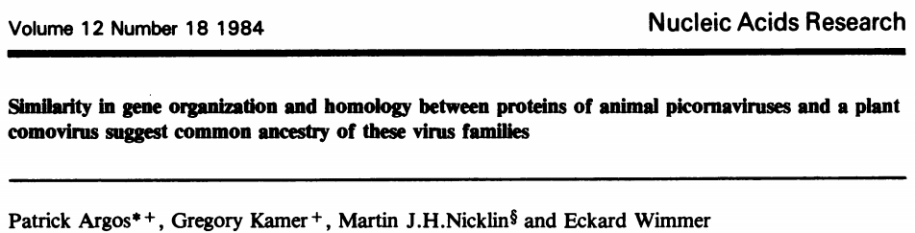
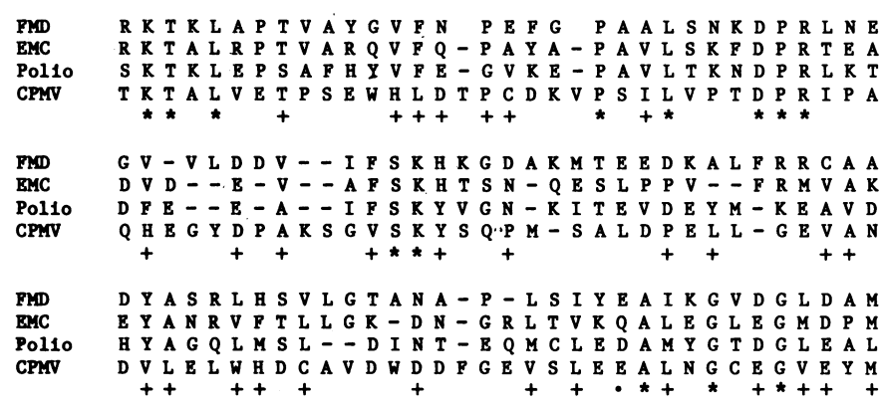
Comparative Genomics
Comparative genomics – Gaining biological insights by comparing genomic features, pre-dates NGS
After we knew the sequence of >1 genome, we compared them!
Multiple sequence alignment showed that seemingly unrelated viruses share similar genes and genome organization!
Sequence similarity can imply evolutionary relatedness, common ancestor
Evolutionary theory is the foundation of comparative genomics
Notes:
Comparative Genomics - Xuhua Xia

Slide 2
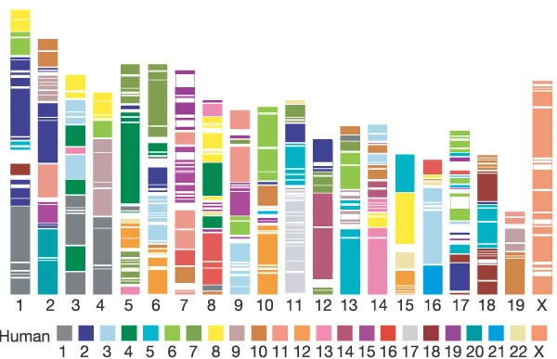
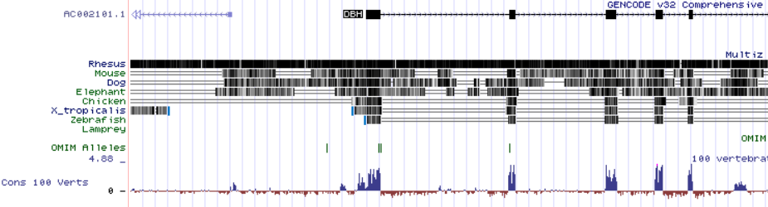
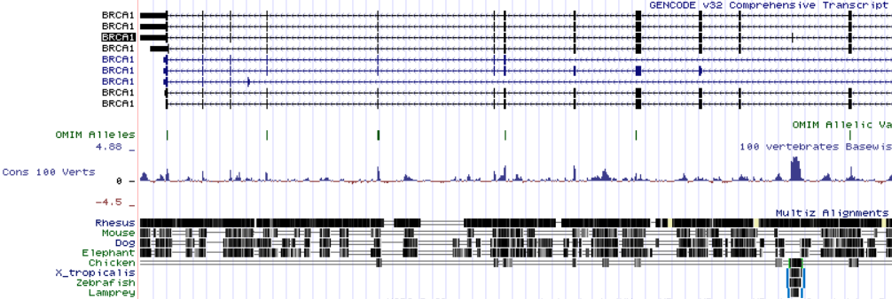
Comparative Genomics
Other motivations for comparing genomes?
Understanding gene function -> Model organisms -> Apply to humans
Mouse, zebrafish, drosophila…we share genes with all of them
Only ~2% of human genome codes for proteins, ~5% is conserved when compared to other vertebrates
Evolution tends to constrain functional elements of genome more than non-functional
Notes:
Initial sequencing and comparative analysis of the mouse genome

Slide 3
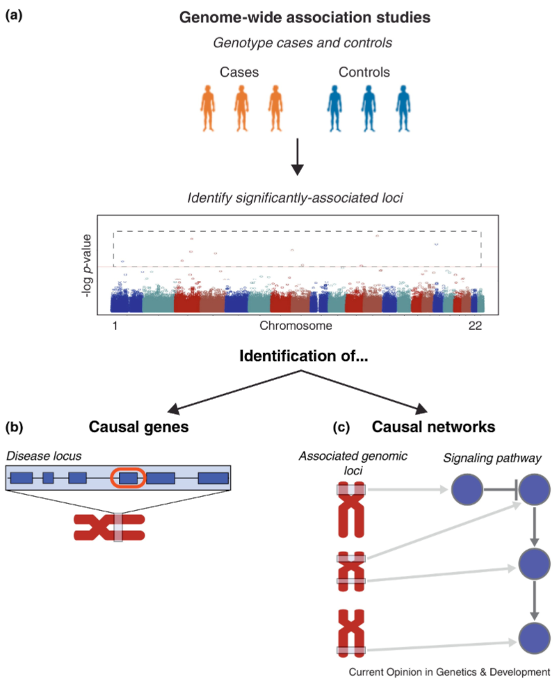
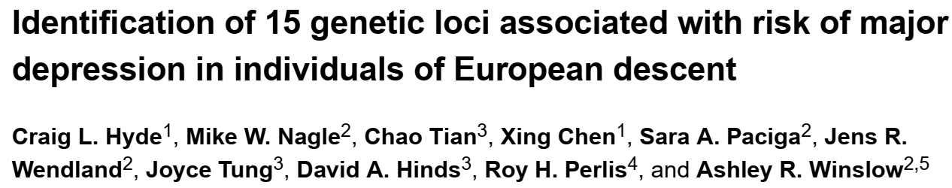
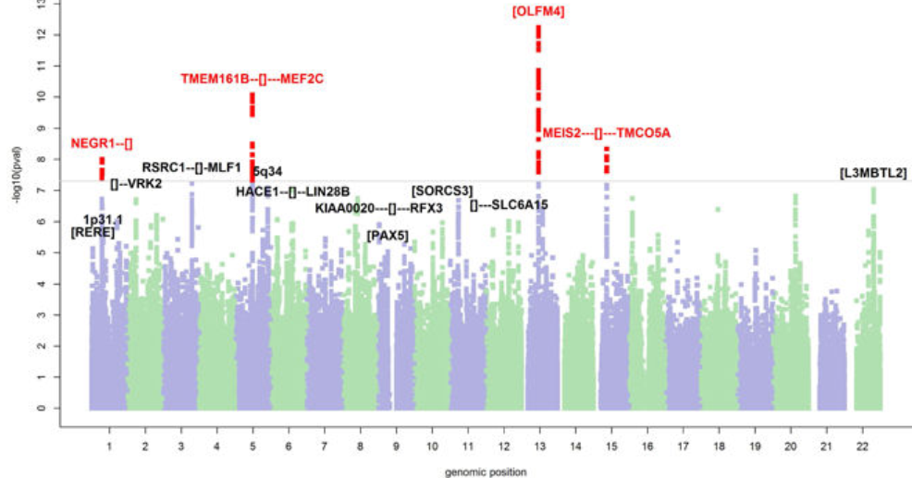
Comparative Genomics
Genome wide association studies (GWAS)
One of the most powerful tools in comparative genomics -> Associate mutations with traits
Often used for human disease traits
Can be used for aiding plant breeding, bee behavior (Dr. Amro Zayed at York)

Slide 4
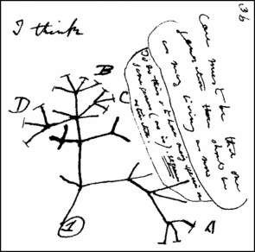
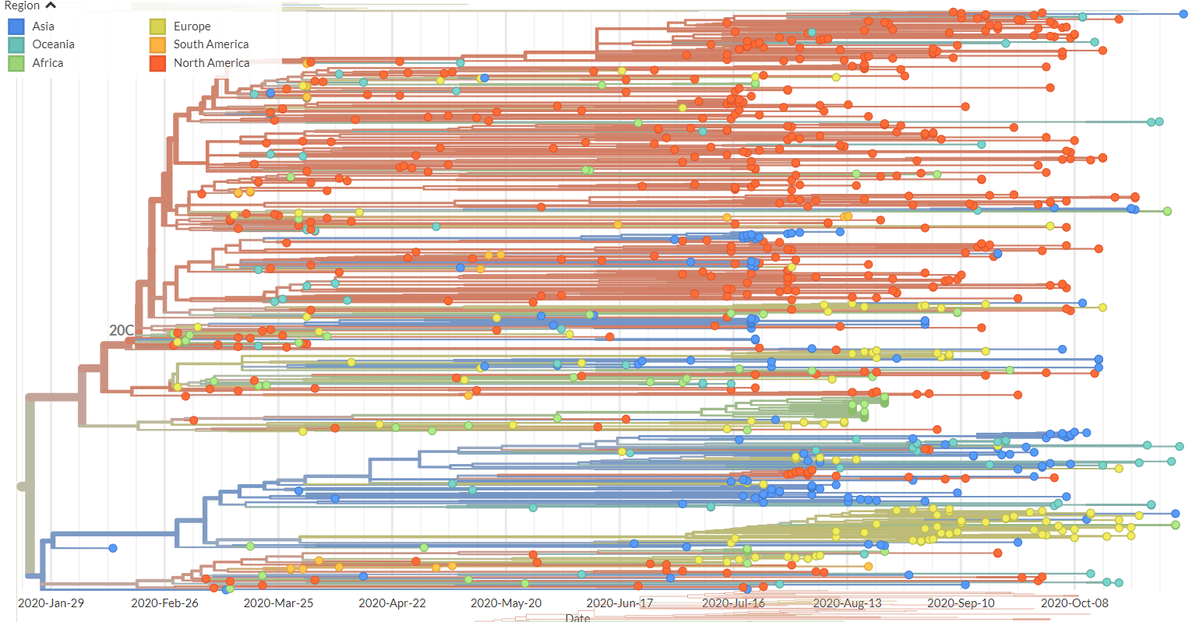
Comparative Genomics
Phylogenetics -> Studying evolutionary history and relationships between and within species, genes etc
How did organisms evolve over time?
Where does a newly discovered organism fit? -> Classification
Can be useful for tracing food contamination, spread of infectious diseases -> HIV, Covid

Slide 5
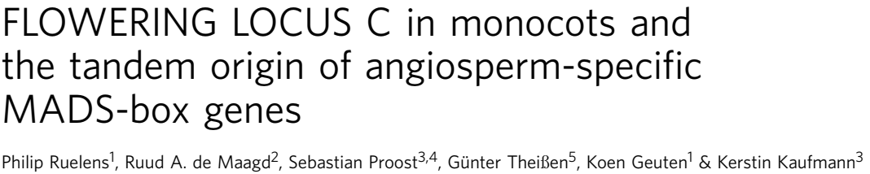
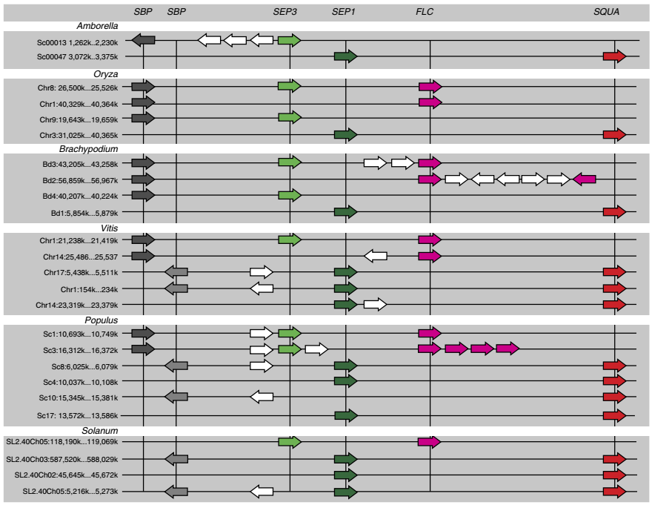
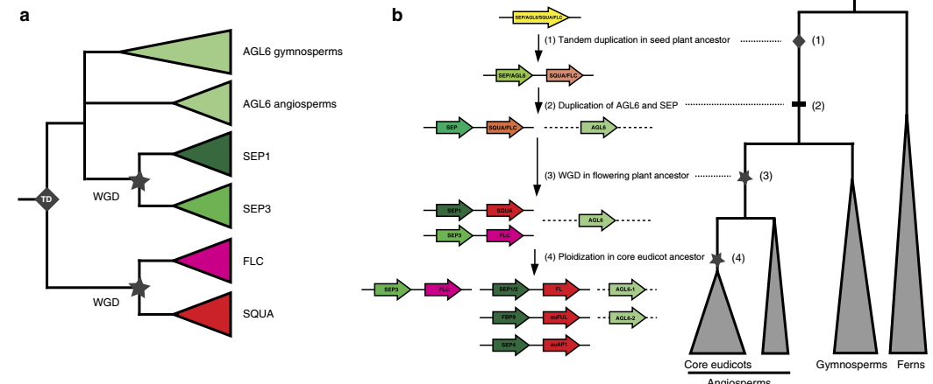
Comparative Genomics
Synteny – Conserved blocks of genes across species
Can be used in together with phylogenetic trees to infer evolutionary history
Notes:
FLOWERING LOCUS C in monocots and the tandem origin of angiosperm-specific MADS-box genes

Slide 6
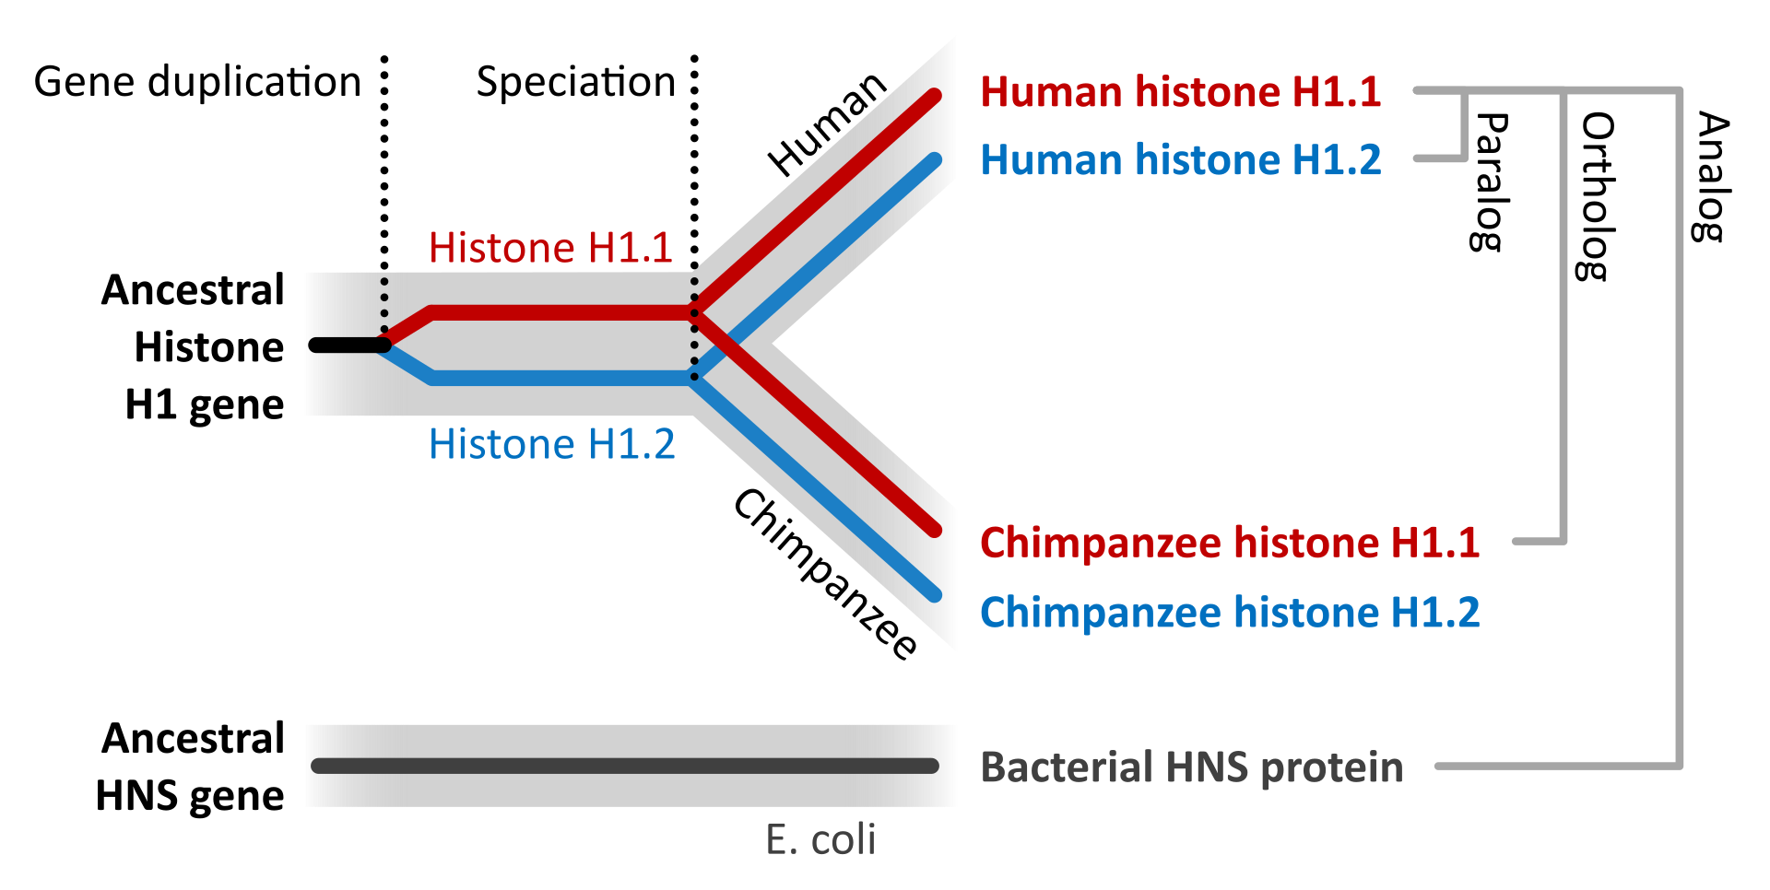
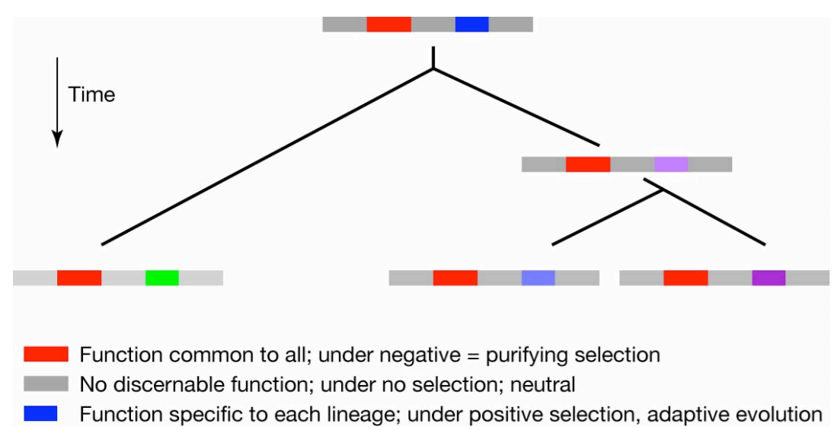
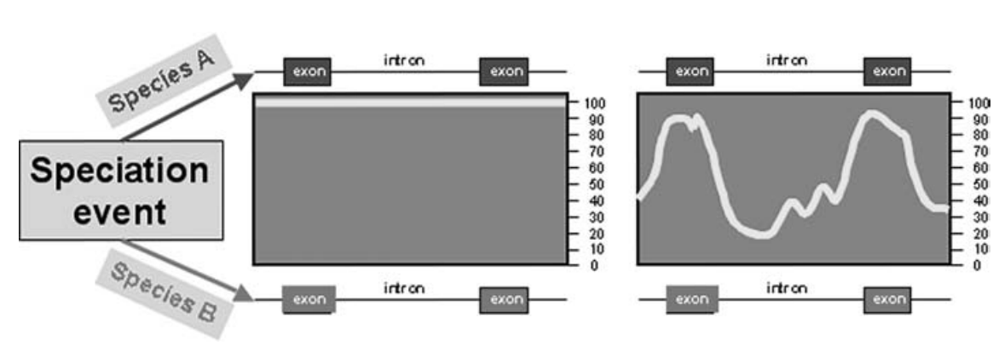
Comparative Genomics
As soon as gene duplication or speciation occurs, genes and genomes will begin to accumulate mutations
Mutations provide the raw material for evolution
Comparing genomes brings insights into evolution -> Evolution helps us understand genomes
Mutations can appear in functional and non-functional regions
Negative mutations in functional areas are subject to negative or purifying selection -> Retain sequence and function
Positive mutations are subject to positive selection and adaptive evolution -> Sequence rapidly changes

Slide 7
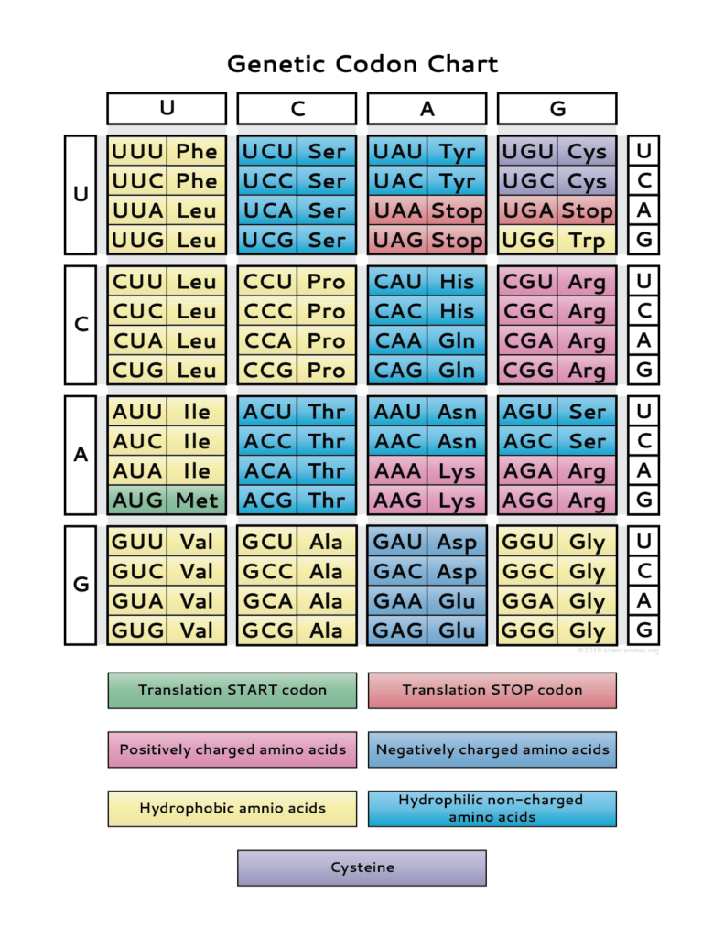
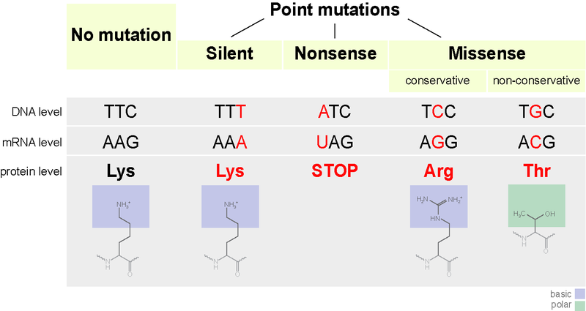
Comparative Genomics
Mutations come in different forms
Synonymous (silent, no AA change) vs non-synonymous (Missense, nonsense)
d_{N}/d_{S} ratio (aka K_{a}/K_{s} ratio) – Ratio of non-synonymous substitutions/synonymous substitutions
d_{N}/d_{S} > 1 -> Gene is experiencing adaptive, positive selection (Genes involved in immunity, reproduction)
d_{N}/d_{S} < 1 -> Gene is experiencing purifying selection

Slide 8
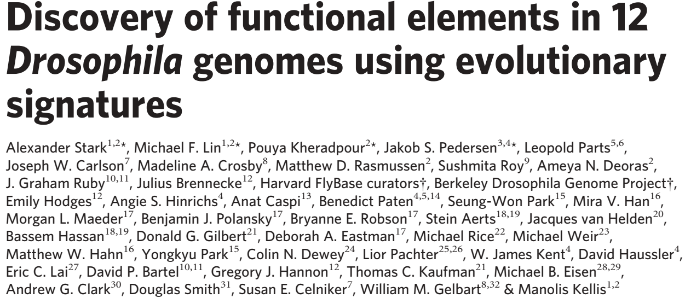
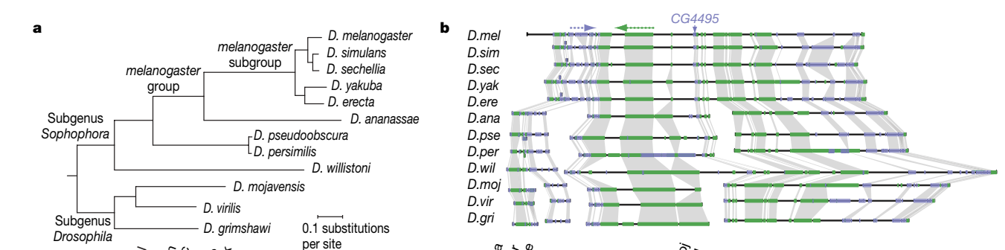
Comparative Genomics
Evolutionary “signatures” can help us annotate genomes
Drosophila is one of the classic model organisms for developmental biology
Notes:
Discovery of functional elements in 12 Drosophila genomes using evolutionary signatures

Slide 9
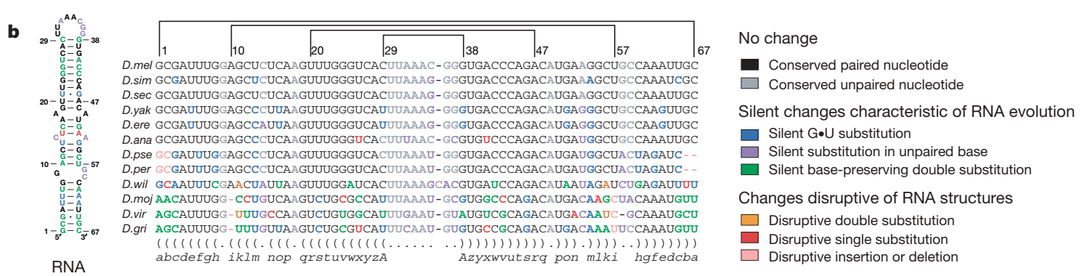
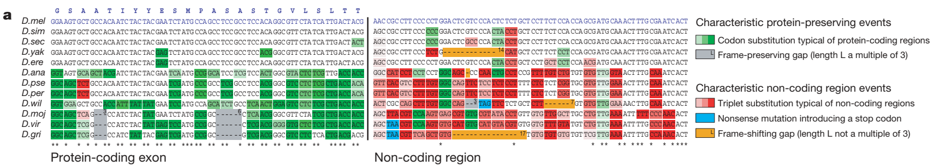
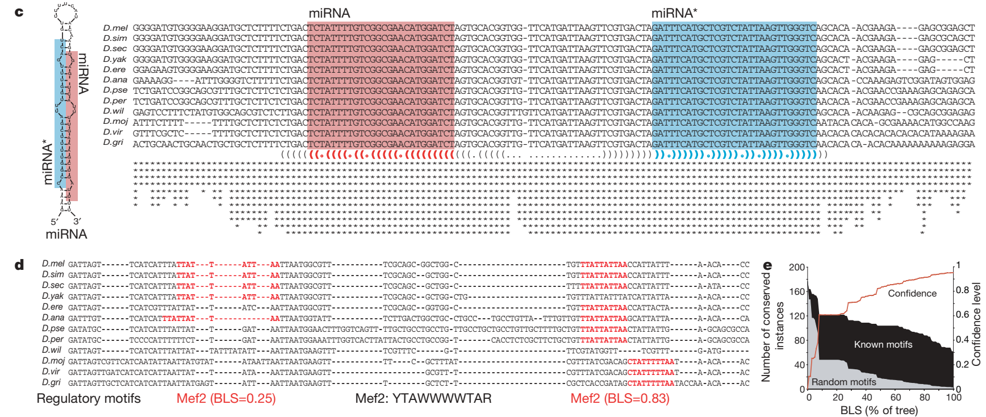
Comparative Genomics
Exons tend to preserve amino acid sequence, have conservative substitutions (Basic -> basic AA), or frame preserving gaps
RNA regulatory structures like riboswitches preserve their whole RNA structure
miRNAs tend to preserve the “stem” of the stem loop sequence
Promoters tend to preserve to binding motifs for TFs
Notes:
Discovery of functional elements in 12 Drosophila genomes using evolutionary signatures

Slide 10
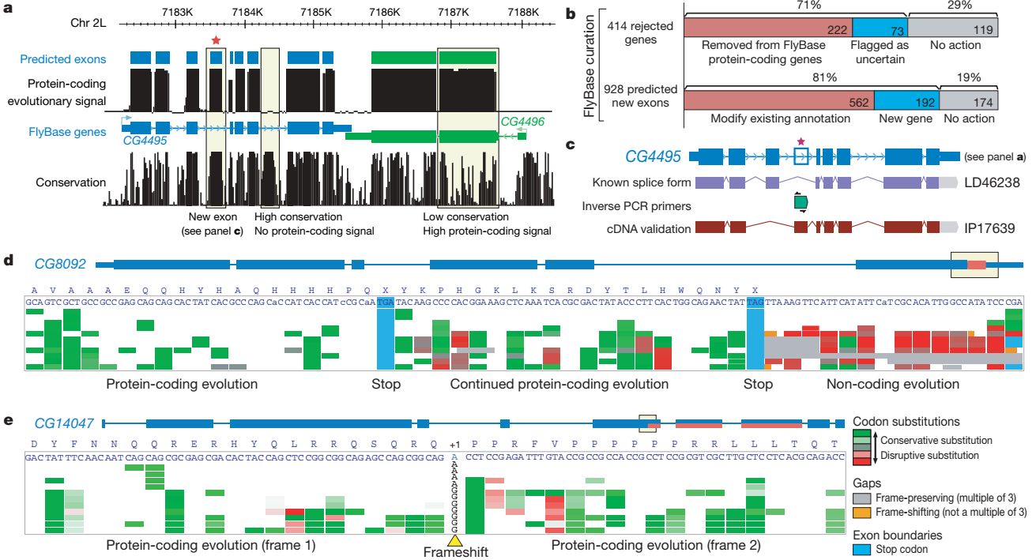
Comparative Genomics
New exons found based on evolutionary signatures! Rejected predicted exons
Evidence of translation read through, frame shift
Notes:
Discovery of functional elements in 12 Drosophila genomes using evolutionary signatures

Slide 11
Comparative Genomics
Phylogenetics -> Studying evolutionary history and relationships between and within species, genes etc
How did organisms evolve over time?
Where does a newly discovered organism fit? -> Classification
Can be useful for tracing food contamination, spread of infectious diseases -> HIV, Covid

Slide 12
Comparative Genomics
Before we learn how to build phylogenetic trees, how do we actually interpret a phylogenetic tree?
Evolutionary time can be number of substitutions in a sequence
Can also be real time if times of disease spread are known, carbon dating
Notes:
http://tbb.bio.uu.nl/BDA/2017/20170214_phylogenetic_trees.pdf
http://epidemic.bio.ed.ac.uk/how_to_read_a_phylogeny <- Dead link, maybe it will come back one day?

Slide 13
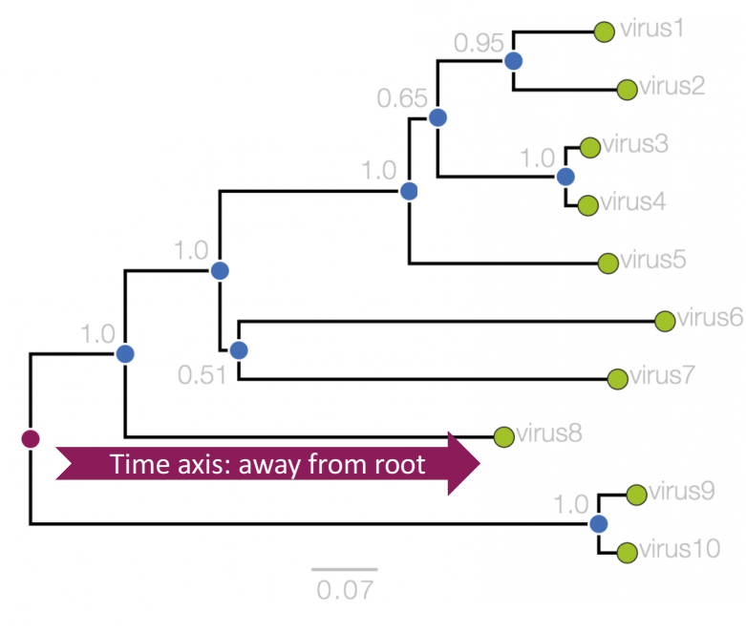
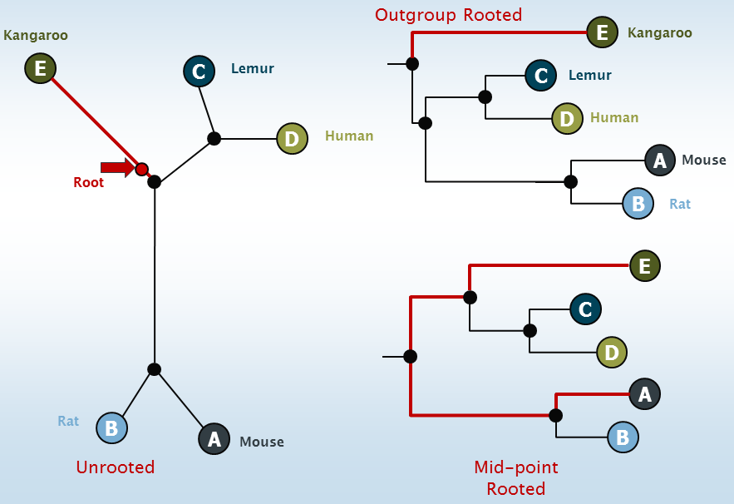
Comparative Genomics
Tips (sometimes called “leaves” or “terminal nodes”)
Present day species or sequences
The data we currently have available
Ancestral nodes (or “internal nodes”)
Last common ancestor of its daughter lineages
Usually inferred data
Root
Last common ancestor of the whole tree
Usually inferred data
Trees can be rooted or unrooted
Root can be placed at midpoint of longest branch
Distantly related species can be used as an outgroup
Notes:
http://tbb.bio.uu.nl/BDA/2017/20170214_phylogenetic_trees.pdf
http://cabbagesofdoom.blogspot.com/2012/06/how-to-root-phylogenetic-tree.html

Slide 14
Comparative Genomics
What is phylogenetic analysis into simpler details and why should we perform it?
Phylogenetic analysis has two major components:
1. Phylogeny inference or “tree building” — the inference of the branching orders, and ultimately the evolutionary relationships, between “taxa” (entities such as genes, populations, species, etc.)
2. Character and rate analysis — using phylogenies as analytical frameworks for rigorous understanding of the evolution of various traits or conditions of interest

Slide 15
Comparative Genomics
Common Phylogenetic Tree Terminology
Terminal Nodes
Branches or
Lineages
A
Represent the
TAXA (genes,
populations,
species, etc.)
used to infer
the phylogeny
B
C
D
Ancestral Node
or ROOT of
the Tree
Internal Nodes or
Divergence Points (represent hypothetical ancestors of the taxa)
E

Slide 16
Comparative Genomics
Phylogenetic trees diagram the evolutionary relationships between the taxa
Taxon B
Taxon C
No meaning to the
spacing between the
taxa, or to the order in
which they appear from
top to bottom.
Taxon A
Taxon D
Taxon E
This dimension either can have no scale (for ‘cladograms’),
can be proportional to genetic distance or amount of change
(for ‘phylograms’ or ‘additive trees’), or can be proportional
to time (for ‘ultrametric trees’ or true evolutionary trees).
((A,(B,C)),(D,E)) = The above phylogeny as nested parentheses
These say that B and C are more closely related to each other than either is to A,
and that A, B, and C form a clade that is a sister group to the clade composed of
D and E. If the tree has a time scale, then D and E are the most closely related.

Slide 17
Comparative Genomics
Three types of trees
Cladogram Phylogram Ultrametric tree
Taxon B
6
Taxon B
Taxon B
1
Taxon C
1
Taxon C
Taxon C
3
Taxon A
1
Taxon A
Taxon A
Taxon D
5
Taxon D
Taxon D
no meaning
genetic change
time
All show the same evolutionary relationships, or branching orders, between the taxa.

Slide 18
A few examples of what can be inferred from phylogenetic trees built from DNA or protein sequence data:
Comparative Genomics
Which species are the closest living relatives of modern humans?
Did the infamous Florida Dentist infect his patients with HIV?
What were the origins of specific transposable elements?
Plus countless others…..

Slide 19
Which species are the closest living relatives of modern humans?
Comparative Genomics
Humans
Gorillas
Chimpanzees
Chimpanzees
Bonobos
Bonobos
Gorillas
Orangutans
Orangutans
Humans
14
0
15-30
0
MYA
MYA
Mitochondrial DNA, most nuclear DNA-encoded genes, and DNA/DNA hybridization all show that bonobos and chimpanzees are related more closely to humans than either are to gorillas.
The pre-molecular view was that the great apes (chimpanzees, gorillas and orangutans) formed a clade separate from humans, and that humans diverged from the apes at least 15-30 MYA.

Slide 20
Did the Florida Dentist infect his patients with HIV?
Comparative Genomics
Phylogenetic tree
of HIV sequences
from the DENTIST,
his Patients, & Local
HIV-infected People:
DENTIST
Patient C
Yes:
The HIV sequences from
these patients fall within
the clade of HIV sequences found in the dentist.
Patient A
Patient G
Patient B
Patient E
Patient A
DENTIST
Local control 2
Local control 3
Patient F
No
Local control 9
Local control 35
Local control 3
Patient D
No
From Ou et al. (1992) and Page & Holmes (1998)

Slide 21
Comparative Genomics
A few examples of what can be learned from character analysis using phylogenies as analytical frameworks:
When did specific episodes of positive Darwinian selection occur during evolutionary history?
Which genetic changes are unique to the human lineage?
What was the most likely geographical location of the common ancestor of the African apes and humans?
Plus countless others…..

Slide 22
Comparative Genomics
What was the most likely geographical location of the common ancestor of the African apes and humans?
Scenario A: Africa as species fountain
Scenario B: Eurasia as ancestral homeland
Modified from: Stewart, C.-B. & Disotell,
T.R. (1998) Current Biology 8: R582-588.
Eurasia = Black
Africa = Red
= Dispersal
Scenario B requires four
fewer dispersal events

Slide 23
Inferred ancestral dispersal patterns of primates between Africa and Eurasia
Comparative Genomics
From: Stewart, C.-B. & Disotell, T.R. (1998) Current Biology 8: R582-588.

Slide 24
Comparative Genomics
The goal of phylogeny inference is to resolve the branching orders of lineages in evolutionary trees:
Completely unresolved
or "star" phylogeny
Partially resolved
phylogeny
Fully resolved,
bifurcating phylogeny
A
A
A
B
C
E
C
E
C
D
B
B
E
D
D
Polytomy or multifurcation
A bifurcation

Slide 25
There are three possible unrooted trees for four taxa (A, B, C, D)
Comparative Genomics
Tree 1
Tree 2
Tree 3
A
C
A
B
A
B
B
D
C
D
D
C
Phylogenetic tree building (or inference) methods are aimed at discovering which of the possible unrooted trees is "correct".
We would like this to be the “true” biological tree — that is, one that accurately represents the evolutionary history of the taxa.
However, we must settle for discovering the computationally correct or optimal tree for the phylogenetic method of choice.

Slide 26
Comparative Genomics
The number of unrooted trees increases in a greater than exponential manner with number of taxa
A
B
C
A
C
B
D
C
A
D
B
E
A
C
D
B
F
E
(2N - 5)!! = # unrooted trees for N taxa

Slide 27
Comparative Genomics
Inferring evolutionary relationships between the taxa requires rooting the tree:
B
To root a tree mentally, imagine that the tree is made of string. Grab the string at the root and tug on it until the ends of the string (the taxa) fall opposite the root:
C
Root
D
Unrooted tree
A
A
B
C
D
Rooted tree
Note that in this rooted tree, taxon A is no more closely related to taxon B than it is to C or D.
Root

Slide 28
Comparative Genomics
Now, try it again with the root at another position:
B
C
Root
Unrooted tree
D
A
A
B
C
D
Rooted tree
Note that in this rooted tree, taxon A is most closely related to taxon B, and together they are equally distantly related to taxa C and D.
Root

Slide 29
Comparative Genomics
An unrooted, four-taxon tree theoretically can be rooted in five different places to produce five different rooted trees
A
2
4
C
The unrooted tree 1:
1
5
B
3
D
Rooted tree 1a
Rooted tree 1b
Rooted tree 1c
Rooted tree 1d
Rooted tree 1e
B
A
A
C
D
A
B
B
D
C
C
C
C
A
A
D
D
D
B
B
These trees show five different evolutionary relationships among the taxa!

Slide 30
Comparative Genomics
All of these rearrangements show the same evolutionary relationships between the taxa
A
A
C
D
D
C
Rooted tree 1a
B
B
B
C
D
A
D
C
C
A
A
B
B
D
B
B
C
D
D
C
A
A

Slide 31
Comparative Genomics
There are two major ways to root trees:
By outgroup:
Uses taxa (the “outgroup”) that are known to fall outside of the group of interest (the “ingroup”). Requires some prior knowledge about the relationships among the taxa. The outgroup can either be species (e.g., birds to root a mammalian tree) or previous gene duplicates (e.g.,
α-globins to root β-globins).
outgroup
By midpoint or distance:
Roots the tree at the midway point between the two most distant taxa in the tree, as determined by branch lengths. Assumes that the taxa are evolving in a clock-like manner. This assumption is built into some of the distance-based tree building methods.
A
d (A,D) = 10 + 3 + 5 = 18
Midpoint = 18 / 2 = 9
10
C
3
2
B
2
5
D

Slide 32
Comparative Genomics
Each unrooted tree theoretically can be rooted anywhere along any of its branches
A
C
x
=
B
D
C
A
D
B
E
C
A
D
B
F
E
(2N - 3)!! = # unrooted trees for N taxa

Slide 33
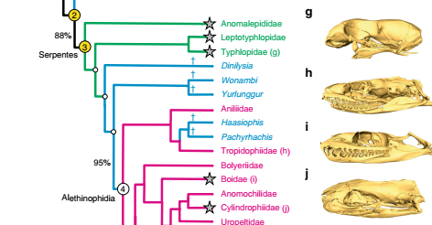
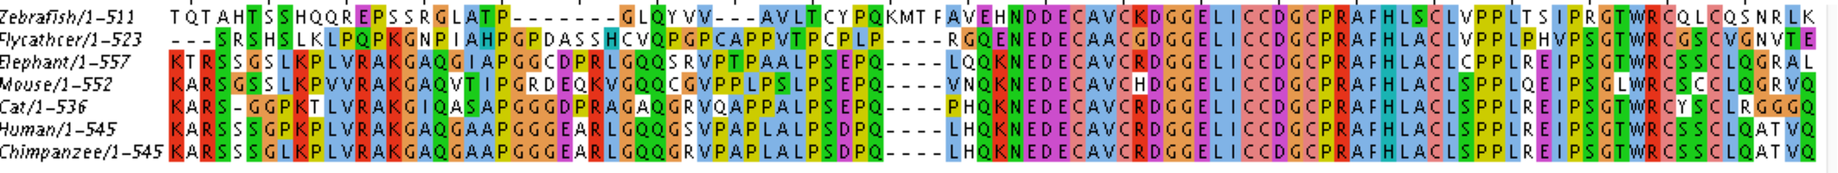
Comparative Genomics
How are trees constructed?
Which characters are you basing your phylogeny on?
Phenotypic
Could be any observable aspect of an organism
Usually expressed as a binary or continuous variable
Genotypic
The DNA/RNA/Protein sequence of an organism or gene
Can be from a multiple sequence alignment (MSA)
With NGS, SNPs are increasingly used
SNPs – Small nucleotide polymorphisms, single nucleotide sequence variants present at >1% of the population
Phylogenetic trees can be constructed with phenotypic data, genotypic, or a combination of both
Notes:
http://tbb.bio.uu.nl/BDA/2017/20170214_phylogenetic_trees.pdf

Slide 34
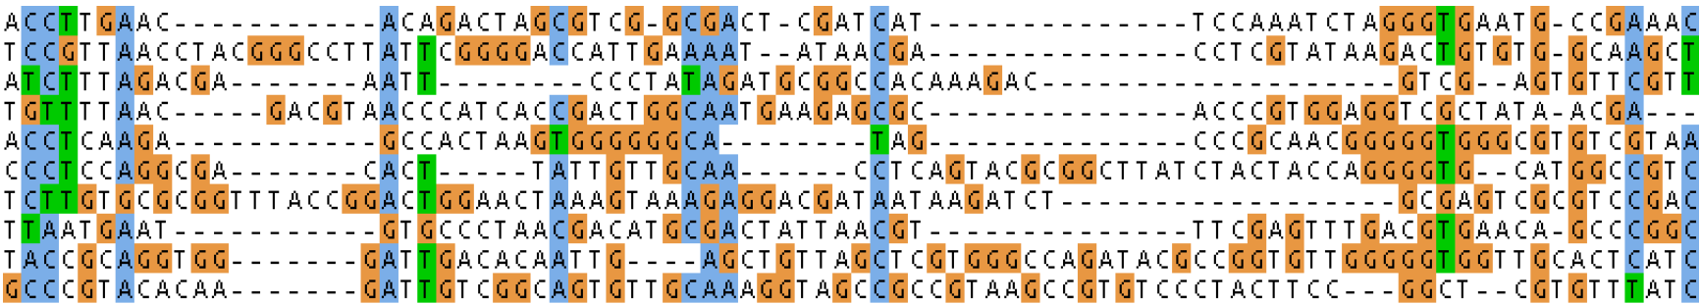
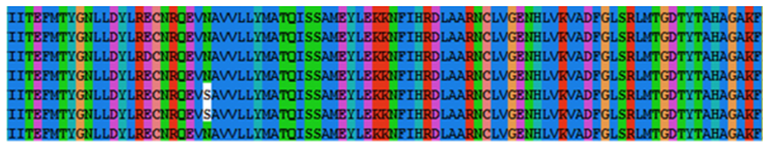
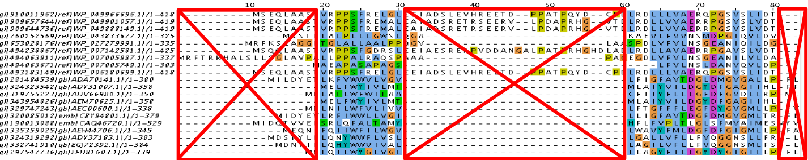
Comparative Genomics
We obtain our sequence data and perform an MSA
Regions of sequences to examine is important for questions being asked
Regions of low conservation – Good for resolving differences in closely related sequences
Regions of high conservation – Good for resolving distantly related sequences
Typically you want a balance between diversity in your sequence and conservation
Removing poorly conserved and aligned blocks can be automated or done by hand
Small nucleotide polymorphisms -> Not just for GWAS! Useful for phylogenetics too
Notes:
http://tbb.bio.uu.nl/BDA/2017/20170214_phylogenetic_trees.pdf

Slide 35
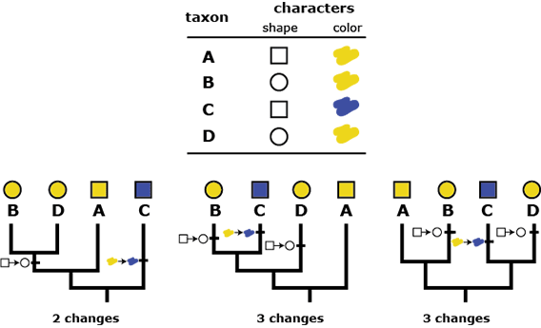
Comparative Genomics
Once you have a high quality MSA with just the right level of sequence conservation, you can build the tree!
Several common tree building methods
Distance based methods like UPGMA (unweighted pair group method with arithmetic mean)
Constructs tree purely based on alignment, makes no assumption about evolution
Parsimony based methods – Assumes evolution is conservative
Best tree is one that explains the change in data with fewest changes
Maximum likelihood based methods – Optimizes most probable tree based on a model
Models makes specific assumptions about evolution
For example, some nucleotide changes are more common than others
And several more!
Generally more computing power is used for advanced models
Phylogenetics catching up to availability of genomics data

Slide 36
Comparative Genomics
Molecular phylogenetic tree building methods:
Are mathematical and/or statistical methods for inferring the divergence order of taxa, as well as the lengths of the branches that connect them. There are many phylogenetic methods available today, each having strengths and weaknesses. Most can be classified as follows:
COMPUTATIONAL METHOD
Optimality criterion
Clustering algorithm
Characters
PARSIMONY
MAXIMUM LIKELIHOOD
DATA TYPE
MINIMUM EVOLUTION
LEAST SQUARES
UPGMA
NEIGHBOR-JOINING
Distances

Slide 37
Types of data used in phylogenetic inference:
Character-based methods: Use the aligned characters, such as DNA or protein sequences, directly during tree inference.
Taxa Characters
Species A ATGGCTATTCTTATAGTACG
Species B ATCGCTAGTCTTATATTACA
Species C TTCACTAGACCTGTGGTCCA
Species D TTGACCAGACCTGTGGTCCG
Species E TTGACCAGTTCTCTAGTTCG
Distance-based methods: Transform the sequence data into pairwise distances (dissimilarities), and then use the matrix during tree building.
A B C D E
Species A ---- 0.20 0.50 0.45 0.40
Species B 0.23 ---- 0.40 0.55 0.50
Species C 0.87 0.59 ---- 0.15 0.40
Species D 0.73 1.12 0.17 ---- 0.25
Species E 0.59 0.89 0.61 0.31 ----
Example 1:
Uncorrected
“p” distance
(=observed percent
sequence difference)
Example 2: Kimura 2-parameter distance
(estimate of the true number of substitutions between taxa)

Slide 38
Comparative Genomics
Similarity vs. Evolutionary Relationship:
Similarity and relationship are not the same thing, even though
evolutionary relationship is inferred from certain types of similarity.
Similar: having likeness or resemblance (an observation)
Related: genetically connected (an historical fact)
Two taxa can be most similar without being most closely-related:
6
Taxon B
1
1
Taxon C
3
C is more similar in sequence
to A (d = 3) than to B (d = 7),
but C and B are most closely
related (that is, C and B shared
a common ancestor more recently
than either did with A).
1
Taxon A
5
Taxon D

Slide 39
Comparative Genomics
Types of Similarity
Observed similarity between two entities can be due to:
Evolutionary relationship:
Shared ancestral characters (‘plesiomorphies’)
Shared derived characters (‘’synapomorphy’)
Homoplasy (independent evolution of the same character):
Convergent events (in either related on unrelated entities),
Parallel events (in related entities), Reversals (in related entities)
C
C
G
G
G
C
C
C
G
G
T
G
G
G
C
C
Character-based methods can tease apart types of similarity and theoretically
find the true evolutionary tree. Similarity = relationship only if certain conditions
are met (if the distances are ‘ultrametric’).

Slide 40
Comparative Genomics
METRIC DISTANCES between any two or three taxa
(a, b, and c) have the following properties:
Property 1: d (a, b) ≥ 0 Non-negativity
Property 2: d (a, b) = d (b, a) Symmetry
Property 3: d (a, b) = 0 if and only if a = b Distinctness
and...
Property 4: d (a, c) ≤ d (a, b) + d (b, c) Triangle inequality:
a
9
c
6
5
b

Slide 41
Comparative Genomics
ULTRAMETRIC DISTANCES
must satisfy the previous four conditions, plus:
Property 5 d (a, b) ≤ maximum [d (a, c), d (b, c)]
4
a
b
This implies that the two largest distances are equal, so that they define an isosceles triangle:
6
6
c
Similarity = Relationship if the distances are ultrametric!
2
a
If distances are ultrametric, then the sequences are evolving in a perfectly clock-like manner, thus can be used in UPGMA trees and for the most precise calculations of divergence dates.
2
2
b
4
c

Slide 42
Comparative Genomics
ADDITIVE DISTANCES:
Property 6:
d (a, b) + d (c, d) ≤ maximum [d (a, c) + d (b, d), d (a, d) + d (b, c)]
For distances to fit into an evolutionary tree, they must be either
metric or ultrametric, and they must be additive. Estimated
distances often fall short of these criteria, and thus can fail to
produce correct evolutionary trees.

Slide 43
Comparative Genomics
Types of computational methods:
Clustering algorithms: Use pairwise distances. Are purely algorithmic methods, in which the algorithm itself defines the tree selection criterion. Tend to be very fast programs that produce singular trees rooted by distance. No objective function to compare to other trees, even if numerous other trees could explain the data equally well. Warning: Finding a singular tree is not necessarily the same as finding the "true” evolutionary tree.
Optimality approaches: Use either character or distance data. First define an optimality criterion (minimum branch lengths, fewest number of events, highest likelihood), and then use a specific algorithm for finding trees with the best value for the objective function. Can identify many equally optimal trees, if such exist. Warning: Finding an optimal tree is not necessarily the same as finding the "true” tree.

Slide 44
Comparative Genomics
Computational methods for finding optimal trees:
Exact algorithms: "Guarantee" to find the optimal or "best" tree for the method of choice. Two types used in tree building:
Exhaustive search: Evaluates all possible unrooted
trees, choosing the one with the best score for the method.
Branch-and-bound search: Eliminates the parts of the
search tree that only contain suboptimal solutions.
Heuristic algorithms: Approximate or “quick-and-dirty” methods that attempt to find the optimal tree for the method of choice, but cannot guarantee to do so. Heuristic searches
often operate by “hill-climbing” methods.

Slide 45
Comparative Genomics
Exact searches become increasingly difficult, and
eventually impossible, as the number of taxa increases:
A
B
A
C
C
B
D
C
A
D
B
E
A
C
D
B
F
E
(2N - 5)!! = # unrooted trees for N taxa

Slide 46
Comparative Genomics
Heuristic search algorithms are input order dependent and can get stuck in local minima or maxima
Rerunning heuristic searches using different input orders of taxa can help find global minima or maxima
Search
for global
maximum
Search
for global minimum
GLOBAL
MAXIMUM
GLOBAL
MAXIMUM
local
maximum
local
minimum
GLOBAL
MINIMUM
GLOBAL
MINIMUM

Slide 47
Comparative Genomics
Classification of phylogenetic inference methods
COMPUTATIONAL METHOD
Optimality criterion
Clustering algorithm
Characters
PARSIMONY
MAXIMUM LIKELIHOOD
DATA TYPE
MINIMUM EVOLUTION
LEAST SQUARES
UPGMA
NEIGHBOR-JOINING
Distances

Slide 48
Comparative Genomics
Parsimony methods:
Optimality criterion: The ‘most-parsimonious’ tree is the one that
requires the fewest number of evolutionary events (e.g., nucleotide
substitutions, amino acid replacements) to explain the sequences.
Advantages:
Are simple, intuitive, and logical (many possible by ‘pencil-and-paper’).
Can be used on molecular and non-molecular (e.g., morphological) data.
Can tease apart types of similarity (shared-derived, shared-ancestral, homoplasy)
Can be used for character (can infer the exact substitutions) and rate analysis.
Can be used to infer the sequences of the extinct (hypothetical) ancestors.
Disadvantages:
Are simple, intuitive, and logical (derived from “Medieval logic”, not statistics!)
Can be fooled by high levels of homoplasy (‘same’ events).
Can become positively misleading in the “Felsenstein Zone”:
[See Stewart (1993) for a simple explanation of parsimony analysis, and Swofford
et al. (1996) for a detailed explanation of various parsimony methods.]

Slide 49
Comparative Genomics
Maximum likelihood (ML) methods
Optimality criterion: ML methods evaluate phylogenetic hypotheses
in terms of the probability that a proposed model of the evolutionary
process and the proposed unrooted tree would give rise to the
observed data. The tree found to have the highest ML value is
considered to be the preferred tree.
Advantages:
Are inherently statistical and evolutionary model-based.
Usually the most ‘consistent’ of the methods available.
Can be used for character (can infer the exact substitutions) and rate analysis.
Can be used to infer the sequences of the extinct (hypothetical) ancestors.
Can help account for branch-length effects in unbalanced trees.
Can be applied to nucleotide or amino acid sequences, and other types of data.
Disadvantages:
Are not as simple and intuitive as many other methods.
Are computationally very intense (Iimits number of taxa and length of sequence).
Like parsimony, can be fooled by high levels of homoplasy.
Violations of the assumed model can lead to incorrect trees.

Slide 50
Comparative Genomics
Minimum evolution (ME) methods
Optimality criterion: The tree(s) with the shortest sum of the
branch lengths (or overall tree length) is chosen as the best tree.
Advantages:
Can be used on indirectly-measured distances (immunological, hybridization).
Distances can be ‘corrected’ for unseen events.
Usually faster than character-based methods.
Can be used for some rate analyses.
Has an objective function (as compared to clustering methods).
Disadvantages:
Information lost when characters transformed to distances.
Cannot be used for character analysis.
Slower than clustering methods.

Slide 51
Comparative Genomics
Clustering methods (UPGMA & N-J)
Optimality criterion: NONE. The algorithm itself builds
‘the’ tree.
Advantages:
Can be used on indirectly-measured distances (immunological, hybridization).
Distances can be ‘corrected’ for unseen events.
The fastest of the methods available (N-J is screamingly fast!).
Can therefore analyze very large datasets quickly (needed for HIV, etc.).
Can be used for some types of rate and date analysis.
Disadvantages:
Similarity and relationship are not necessarily the same thing, so clustering by
similarity does not necessarily give an evolutionary tree.
Cannot be used for character analysis!
Have no explicit optimization criteria, so one cannot even know if the program
worked properly to find the correct tree for the method.

Slide 52
Comparative Genomics
Statistical Tests Comparing Trees
Tests of one overall hypothesis (tree) against other hypotheses
Wilson’s “winning sites” test
Templeton’s test
Kishino-Hasegawa ML test
Tests of strength of support for lineages within trees:
Bootstrap
Jack-knife
Decay index
These are implemented for numerous phylogenetic methods in PAUP*.

Slide 53
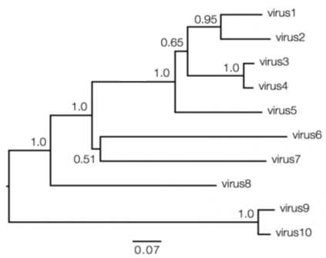
Comparative Genomics
Okay, we have a tree, what do these numbers mean??? Branch support values
Bootstrapping -> Taking sub-samples of the data, creating a new tree, observing changes in tree….x100-1000
0.95 -> Out of 1000 generated trees, 950 trees placed that node in that location
Nodes with very low support will be collapsed into others
Caveat with phylogenetic trees -> They’re hypothesis! We often don’t have ancestral sequences

Slide 54
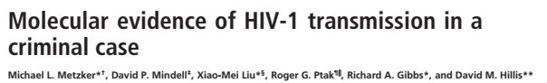
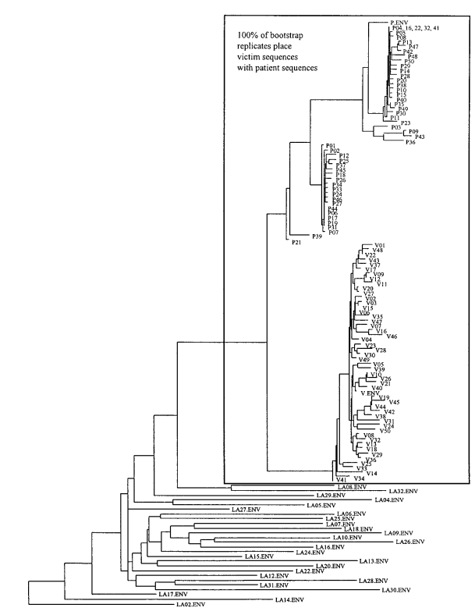
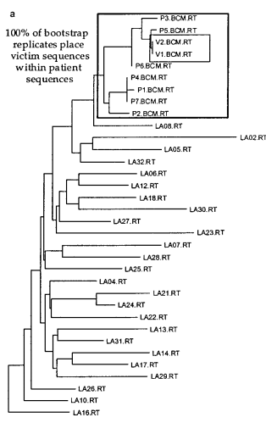
Comparative Genomics
Phylogenetic trees aren’t just for deducing evolutionary lineages
Richard J. Schmidt, (former) physician accused of injecting his ex-gf with HIV-I (extracted from HIV+ patient that same day…)
Viral reverse transcriptase and gp120 genes PCR amplified from blood sample
Victim compared against Patient and other local HIV+ patients

Slide 55
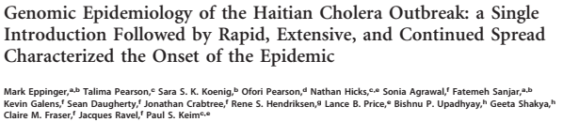
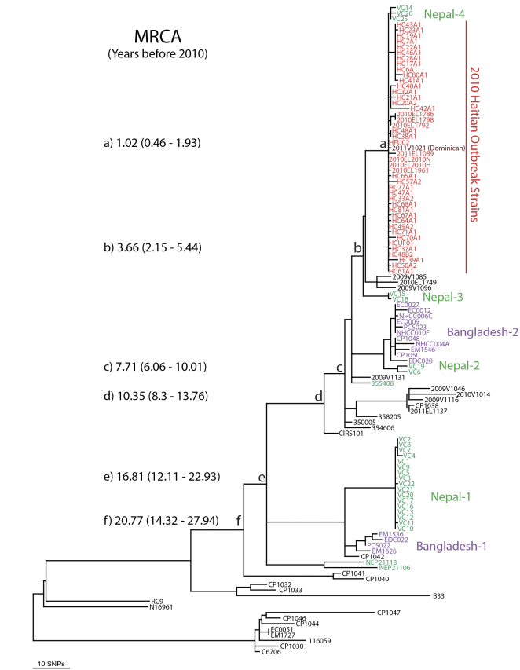
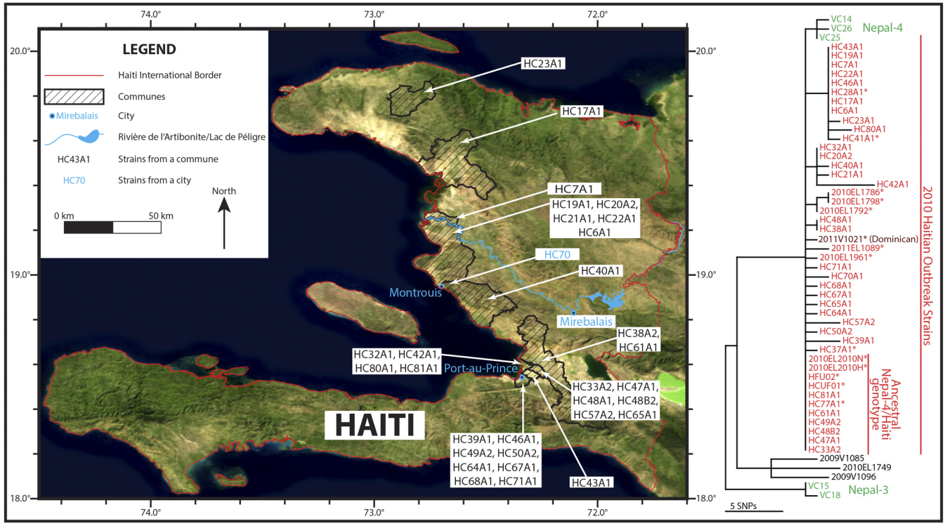
Comparative Genomics
A more recent case, the 2010 Cholera outbreak in Haiti (Haiti hasn’t had a Cholera outbreak in 100 years)
UN Peacekeepers from Nepal accused of dumping sewage into a nearby river, infecting 100,000s of people
Researchers used SNPs to generate trees to classify newly discovered Haitian strains as descended from Nepalese strains
Molecular clock calibrated based on previously isolated strains

Slide 56
Comparative Genomics
Genome wide association studies (GWAS)
Associate genetic variation with traits without prior knowledge of involved genes
Applications in humans disease, plant breeding, behavior
1

Slide 57
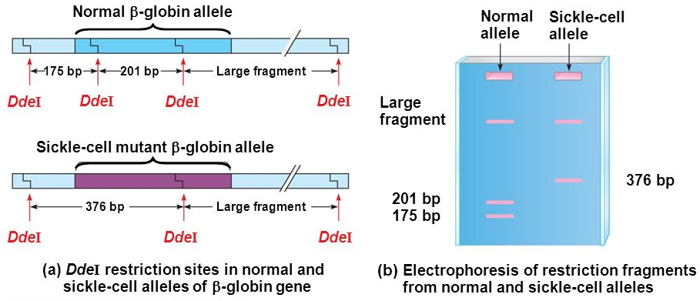
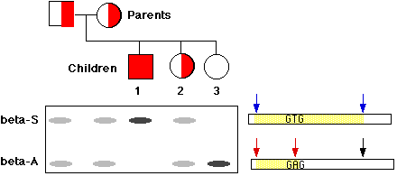
Comparative Genomics
Let’s back it up, how was genetic variation measured in the past?
Restriction fragment length polymorphisms (RFLPs)
Presence/absence of a RFLP due to change in nucleotide sequence
RFLP can be within disease causing gene or linked to a disease gene
2

Slide 58
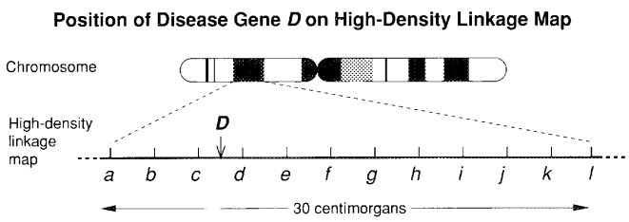
Comparative Genomics
RFLPs can be used as markers for diseases if RFLP and disease gene are linked (close together on chromosome)
Recombination between marker c and disease D are rarely observed
Used to identify CFTR gene as the cause of cystic fibrosis, the HD gene for Huntington’s (rare disorders)
Effect of genetic variants is strong enough to be autosomal dominant
What about common problems like hypertension? Cancer? Not as useful, why?
Individual affected by the disease
Parents
c1c1
c1c2
Individual not affected by the disease
Offspring
c1c2
c1c1
c1c2
c1c1
c1c2
c1c2
c1c1
c1c1
c2
c1
RFLPs for marker c
3
Notes:
Modern Linkage Mapping with polymorphic DNA markers — a tool for finding genes

Slide 59
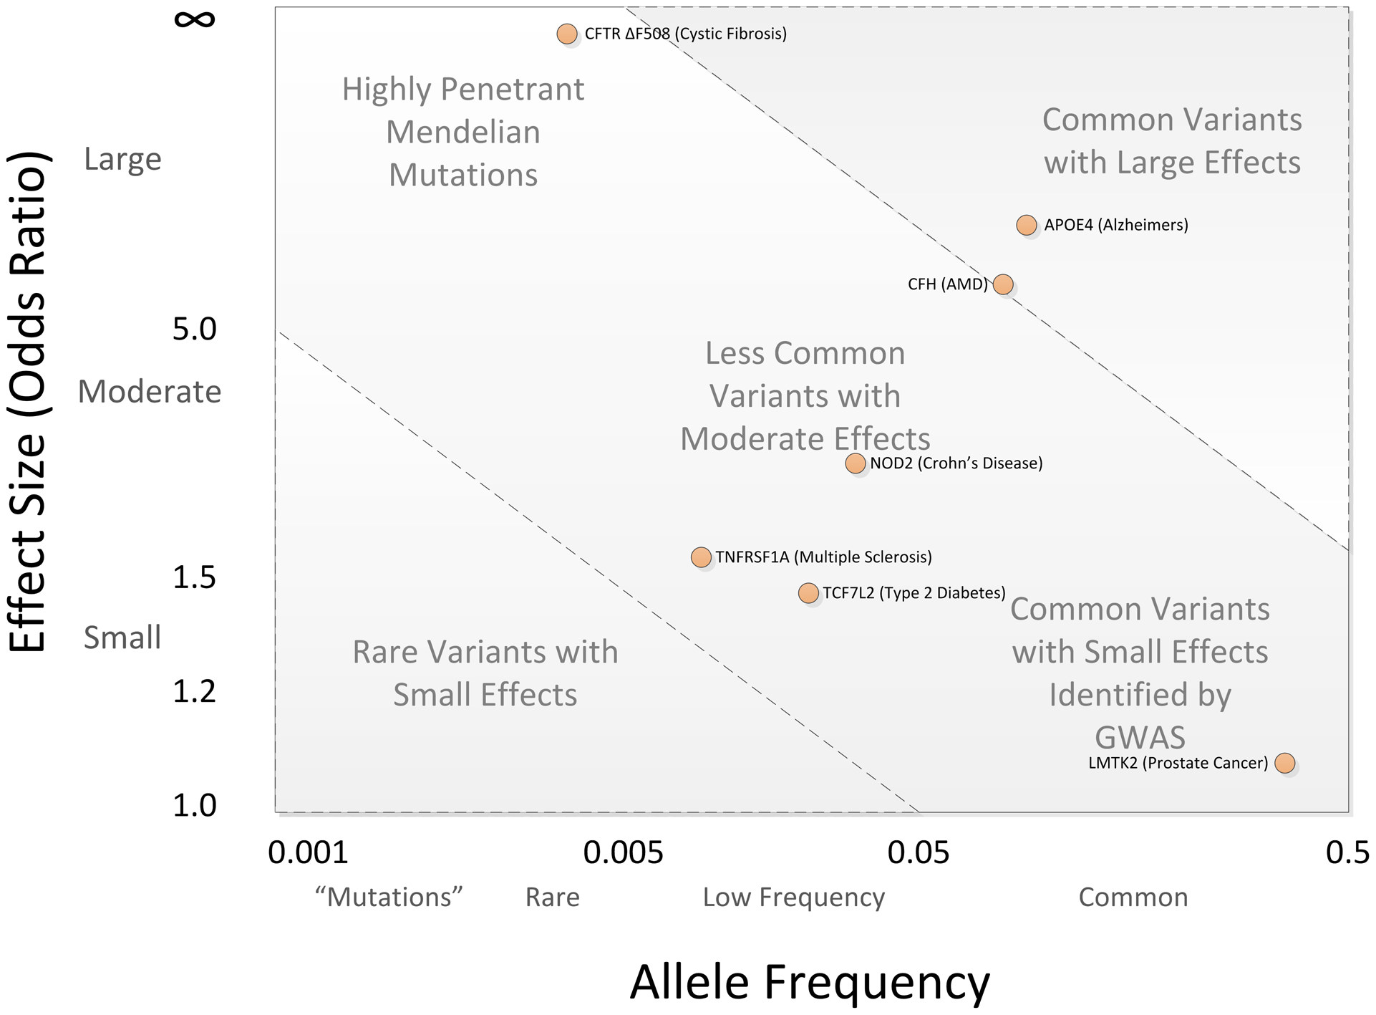
Comparative Genomics
Common disease/Common variant hypothesis – Common disorders are inflicted by common variations with small effect size
Common disease/Rare variant hypothesis – Common disorders are inflicted by rare variations with large effect size
Effect size (Penetrance) – How likely you are to have a specific disease/trait/etc if you have a certain variant
If multiple variants contribute to a disease phenotype, linkage association will not work
We need large sample sizes (population level) for complex diseases
How do we measure variation?
4
Notes:
Modern Linkage Mapping with polymorphic DNA markers — a tool for finding genes
Chapter 11: Genome-Wide Association Studies - https://journals.plos.org/ploscompbiol/article?id=10.1371/journal.pcbi.1002822

Slide 60
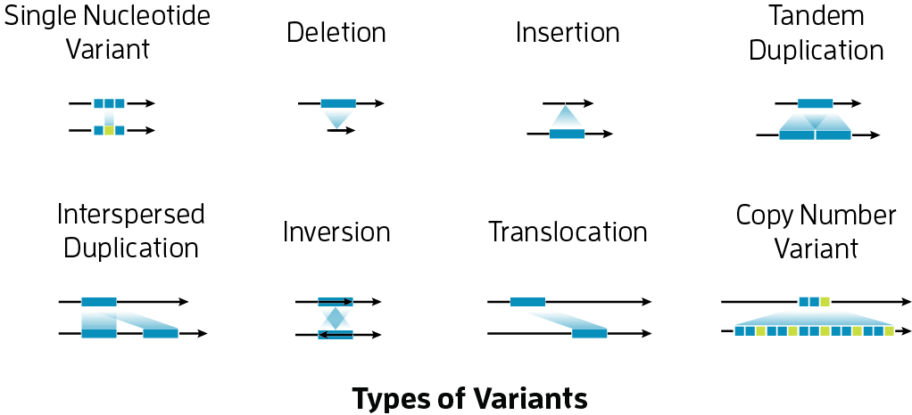
Comparative Genomics
Variation between an individual and reference genome? Single nucleotide variation (SNV)
Variation between >1% of population and reference? Single nucleotide polymorphism (SNP)
Variations between individuals come in different forms
SNVs are most common, 1 in 300bp
Individual 1: agaatgagaaaaatcctaaGccaatagaatcactcgaaaaagaCtctgctttcaaaacga
Individual 2: agaatgagaaaaatcctaaGccaatagaatcactcgaaaaagaatctgctttcaaaacga
Individual 3: agaatgagaaaaatcctaaGccaatagaatcactcgaaaaagaatctgctttcaaaacga
Individual 4: agaatgagaaaaatcctaaGccaatagaatcactcgaaaaagaCtctgctttcaaaacga
Individual 5: agaatgagaaaaatcctaaGccaatagaatcactcgaaaaagaatctgctttcaaaacga
Individual 6: agaatTagaaaaatcctaacccaatagaatcactcgaaaaagaatctgctttcaaaacga
Individual 7: agaatgagaaaaatcctaacccaatagaatcactcgaaaaagaatctgctttcaaaacga
Individual 8: agaatgagaaaaatcctaacccaatagaatcactcgaaaaagaCtctgctttcaaaacga
Individual 9: agaatgagaaaaatcctaacccaatagaatcactcgaaaaagaatctgctttcaaaacga
Individual 10: agaatgagaaaaatcctaacccaatagaatcactcgaaaaagaatctgctttcaaaacga
0.01%
SNV
50%
SNP
1%
SNP
5

Slide 61
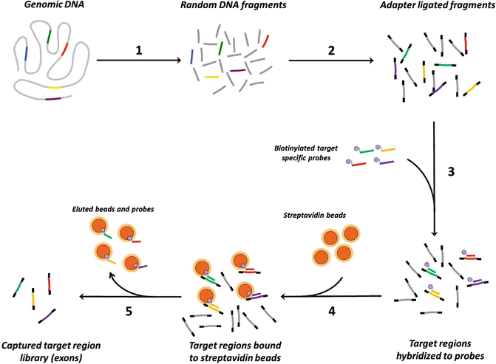
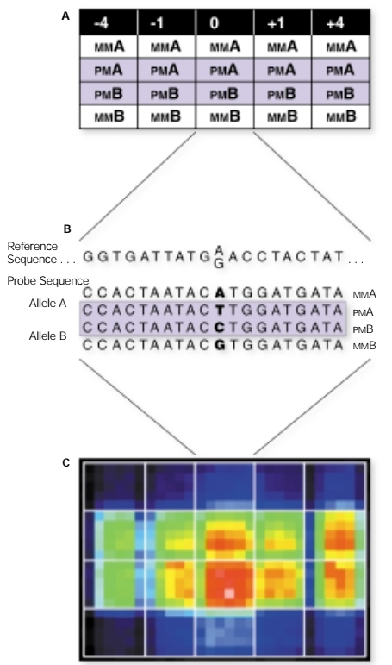
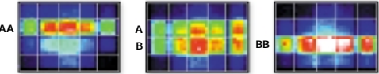
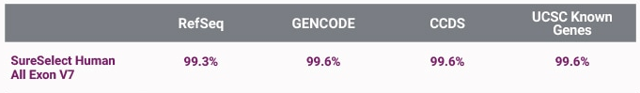
Comparative Genomics
Two alternatives to whole genome seq
Microarrays – DNA probes on chips detect known SNPs
Whole exome sequencing – Enrich for exon sequences with probes
Both techniques very useful for studies with many samples (100,000s)
Both can only capture known SNPs, exome seq -> only captures SNPs in exons
6

Slide 62
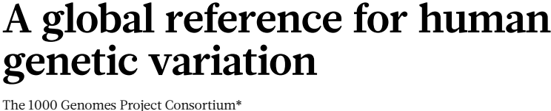
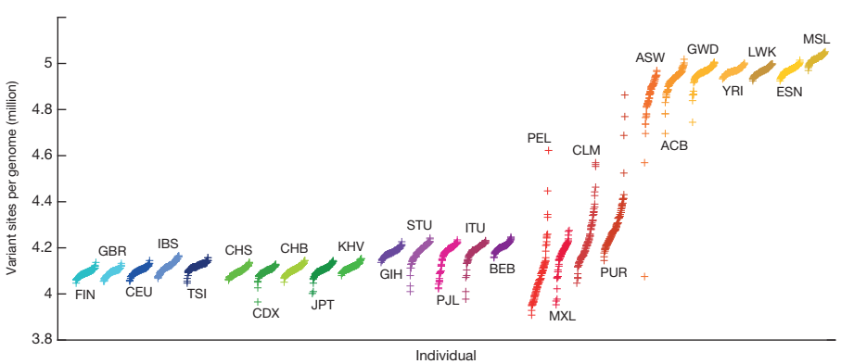


Comparative Genomics
Population scale human genome sequencing now possible
1000 Genomes project - ~2500 individuals across the globe, 30-50$ million dollar effort in 2015
80+ million SNPs, 3+ million indels, 60,000 structural variants
7
Notes:
A global reference for human genetic variation

Slide 63



Comparative Genomics
What’s the point of gathering all these SNPs etc?
Very rarely, SNPs will land directly in a protein coding gene and disrupt its function -> Functional SNPs -> Direct association
More often, SNPs will be found close to disease associated genes -> Tag SNPs -> Indirect association
SNPs close together will segregate together -> Are said to be in linkage disequilibrium (LD)
A haplotype is a region of DNA containing variations that tend to be inherited due to LD
Haplotypes identified in European populations may not be relevant for African populations -> More time to diverge
8
Notes:
Chapter 11: Genome-Wide Association Studies - https://journals.plos.org/ploscompbiol/article?id=10.1371/journal.pcbi.1002822
Genome-wide association studies for common diseases and complex traits

Slide 64

Comparative Genomics
Traits you are measuring can be continuous like height, cholesterol level
Can be categorical/binary -> Affected or non-affected individuals, needs strict phenotype criteria to be effective
Statistical corrections need to be performed for covariates like sex, age and ethnic group
Finally, we can start performing statistical analysis to determine if a SNP significantly affects a trait
Don’t forget correcting for multiple statistical tests!
9
Notes:
Diagnostic criteria for multiple sclerosis: 2005 revisions to the “McDonald Criteria”

Slide 65


Comparative Genomics
When interpreting GWAS you’ll often be presented with a Manhattan plot -> Plotting significance value vs genomic position
One significance test, p value < 0.05, 1 MILLION significance tests? 0.05/1,000,000 = ~ 5 x 10⁻⁸
QQ plots – Plotting observed p values VS expected p values from a null hypothesis
Early departure from expected p values could indicate confounding variables like population structure
1

Slide 66



Comparative Genomics
Let’s look at one of the first major GWAS studies
Genotyped ~17000 UK individuals for 7 different diseases, ~3000 controls and 2000 patients per disease
BD - Bipolar disorder, CAD - Coronary artery disease, CD - Crohn's disease, HT – Hypertension, RA - Rheumatoid arthritis
T1D - Type 1 Diabetes, T2D - Type 2 Diabetes
2

Slide 67

Comparative Genomics
Findings of study confirmed previous links between RA, T1D and the major histocompatibility complex (MHC)
All SNPs with large effect sizes had already been found -> Good thing, replication is important!
Novel SNPs significantly associated with disease found to have modest (small) odds ratio
RA significantly more common in women -> Found a sex differentiated SNP
Replication of RA SNP not found in North American women, hidden population effect?
3

Slide 68

Comparative Genomics
GWAS has led to an explosion of identified risk alleles for complex diseases
Larger sample sizes needed to detect variants with small effects (Lower odds ratios)
70 SNPs and counting!
OR >1.25
~3500 Individuals
OR >1.25
~6500 Individuals
More
SNPs/genes
OR >1.5
~1700 British
OR ~4.0
Linkage analysis
~250 family triads
OR ~2.2
Linkage analysis
~500 Japanese
~300 British
OR ~1.6
~1000 Individuals
_______
2010
4
Notes:
Genome-Wide Association Studies in Inflammatory Bowel Disease - Richard H. Duerr, M.D.

Slide 69


Comparative Genomics
Statistical power – Probability of finding a true positive effect
Greater sample sizes -> More power
More power can also be gained by imputation
Imputation fills in missing SNPs based on previous reference information
5
Notes:
Genome-wide association defines more than thirty distinct susceptibility loci for Crohn's disease
Genotype imputation for genome-wide association studies

Slide 70

Comparative Genomics
More power -> More loci discovered
Schizophrenia wasn’t thought to be due to common variants, was just a matter of power
Okay, so we have all these SNPs, what is actually actionable about them?
6
Notes:
https://mit6874.github.io/

Slide 71

Comparative Genomics
Disease associated SNPs can be used select nearby genes for functional analysis -> Mouse, cell culture models
Rarely, the identified genes can be used as drug targets
90% of the time SNPs fall into regions of (currently) unknown function, is the data still useful? Absolutely!
7
Notes:
10 Years of GWAS Discovery: Biology, Function, and Translation

Slide 72



Comparative Genomics
Polygenic risk scores (PRS) – Sum of all risk alleles carried by an individual, weighted by effect size
Will increasingly be used in clinical setting along with standard risk factors to get a combined risk estimate
Women in top 1% of PRS for breast cancer 3X more likely to develop cancer, ~5% vs 15%
8
Notes:
The personal and clinical utility of polygenic risk scores

Slide 73


Comparative Genomics
PRS scores should be interpreted carefully, to date most GWAS can account for 5-15% of disease variation
That has not stopped some people….
Will we reach a point at which we can accurately predict risk? Implications on ethics?
9

Slide 74





Comparative Genomics
GWAS is not just widely used in genetics studies, intersection between genetics and social sciences?
Findings could infer better understanding of human sexuality above Kinsey scale/Klein Grid etc
Five genome wide significant SNPs found near hormone regulatory genes
10
Notes:
Large-scale GWAS reveals insights into the genetic architecture of same-sex sexual behavior

Slide 75

Comparative Genomics
Study was not without its criticisms, interesting letter/response exchange
Bring up points about consent obtained about data usage, missing historical contexts
11
Notes:
Genome studies must account for history

Slide 76



Comparative Genomics
What about other interesting GWAS studies?
Follow up from previous study of educational achievement (EA) GWAS with ~250,000 individuals ->74 loci
1,100,000 individuals? >500 significant loci
Many significantly associated SNPs found in genes implicated in brain development, especially in early life
Gene discovery and polygenic prediction from a 1.1-million-person GWAS of educational attainment
1
Notes:
Gene discovery and polygenic prediction from a 1.1-million-person GWAS of educational attainment

Slide 77





Comparative Genomics
Researchers used their GWAS data to develop a polygenic score (PGS) to predict EA
Data can explain 10-12% of variation in EA, more than household income, less than education of parents
Dataset generated from European individuals not useful for African-Americans (85% attenuation)
Social stratification -> genetic stratification -> Explains genetic variance in EA?
2
Notes:
Gene discovery and polygenic prediction from a 1.1-million-person GWAS of educational attainment

Slide 78








Comparative Genomics
Personalized medicine on the horizon thanks to GWAS
Drugs can be metabolized faster or slower depending on your genotype
Can also predict response to antivirals and adverse reactions to anti-seizure drugs
3
Notes:
Gene discovery and polygenic prediction from a 1.1-million-person GWAS of educational attainment

Slide 79



Comparative Genomics
So, has GWAS been successful?
2 review articles over the course of 10 years (2012, 2017), same peeps
What do I have to understand
from these papers???
What were some of the early criticisms for GWAS?
How does sample size correlate with # of loci discovered?
What were the authors opinions on population stratification?
Does the current evidence support the CDCV or CDRV hypothesis?
How has GWAS changed over time?
4
Notes:
Paper 10: Five Years of GWAS Discovery
Paper 11: 10 Years of GWAS Discovery: Biology, Function, and Translation

Slide 80

Comparative Genomics
Aligning a few thousand base pairs of DNA, no big deal
Aligning entire genomes? More formidable task -> Gaps, duplications, repetitive DNA
Synteny blocks - regions between genomes with shared order of homologous genes derived from a common ancestor
Homologous genes between organisms used as anchors for local alignment
Genes can be in same order on chromosomes or inverted
Different thresholds exist to define syntenic blocks, 3+ homologous genes, with or without gaps
5
Notes:
Inferring synteny between genome assemblies: a systematic evaluation

Slide 81



Comparative Genomics
Accurate identification of synteny dependant on a good genome assembly
Poor synteny can cause spurious GO term association
An N50 of ~1MB for assembled genomes a good starting point for determining syntenic blocks
6
Notes:
Inferring synteny between genome assemblies: a systematic evaluation

Slide 82



Assignment #3
Timely COVID-19 themed analysis!
Multi-part assignment -> Phylogenetic analysis + Assembly/annotation/variant calling
Background - Severe acute respiratory syndrome coronavirus 2 (SARS-CoV-2 AKA Covid-19)
Covid-19 part of the Coronaviridae family, Betacoronavirus genus, ~30,000 bp positive-sense ssRNA genome
Spike (S) glycoprotein is recognized by the host cell’s ACE2 receptor, initiates endocytosis and infection
Coronaviruses infect many, many animals, what could have been a possible source/intermediate host for Covid-19?
1

Slide 83





Assignment #3
You will be using the NCBI’s databases, MEGA X software (Windows/Mac/Linux compatible), NGPhylogeny.fr
First things first, get your data -> https://www.ncbi.nlm.nih.gov/sites/batchentrez
List of accessions #s
In text file
Fasta file with spike protein AA seqs
1

Slide 84






Assignment #3
Install Mega X and launch it
First step in analysis? Create a good quality MSA
1

